Slide 1

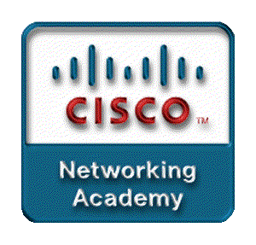
Chapter 2
Switch Concepts and Configuration
Part I

Slide 2
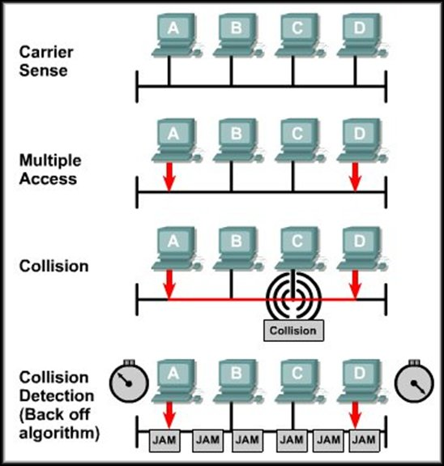
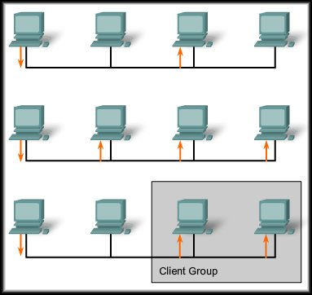
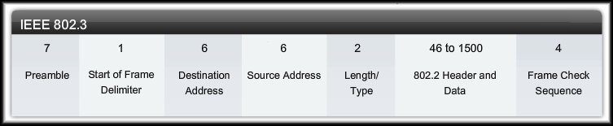
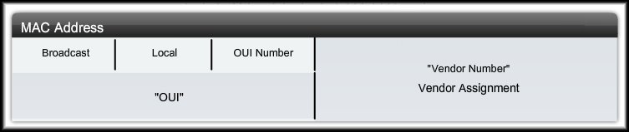
Switch Concepts and Configuration
Key Elements of
Ethernet/802.3 LANs

Slide 3
CSMA/CD

Slide 4
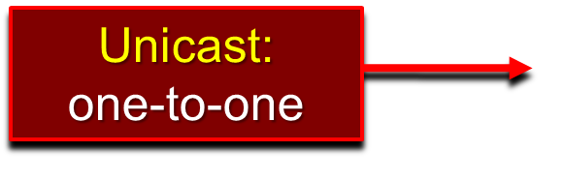
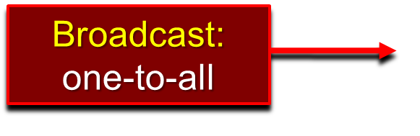
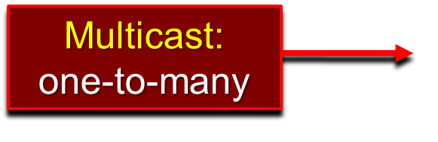
Ethernet Communications

Slide 5
Ethernet Communications
Ethernet Frame: Minimum 64 bytes, Maximum 1518 bytes
Preamble/SOFD: Synchronize to medium.
Destination Address: MAC Address of destination device.
Source Address: MAC address of source device.
Length/Type: Length of frame or protocol type code.
Data: Encapsulated data from OSI Layers 7 to 3.
FCS: Frame Check Sequence.

Slide 6
Ethernet Communications
MAC Address: 12 hexadecimal digits
Broadcast: Indicates a broadcast or multicast frame.
Local: indicates whether the address can be modified locally.
OUI Number: Manufacturer of the NIC.
Vendor Number: Unique, vendor assigned number.

Slide 7
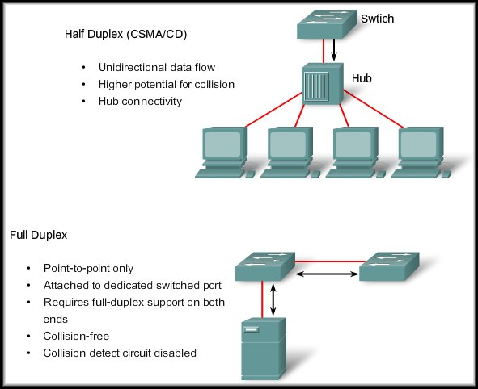
Ethernet Communications

Slide 8
Ethernet Communications
Switch Port Settings:
  AUTO:
    Auto-negotiation of duplex mode. The two ports communicate to determine the best mode.
      Default for FastEthernet and 10/100/1000 ports.
  FULL:
    Full-duplex mode.
      Default for 100BASE-FX ports.
  HALF:
    Half-duplex mode.
Configuration commands later in the chapter.

Slide 9
Ethernet Communications
Switch Port Settings:
  AUTO:
    Auto-negotiation of duplex mode. The two ports communicate to determine the best mode.
  Auto-negotiation can produce unpredictable results.
    If auto-negotiation fails because the attached device does not support it, the Catalyst switch defaults the switch port to half-duplex mode.
    Half-duplex on one end and full-duplex on the other causes late collision errors at the half-duplex end.
    To avoid this, manually set the duplex parameters of the switch to match the attached device.

Slide 10
Ethernet Communications
Switch Port Settings:
  Auto-MDIX feature:
    In the past, either a cross-over or a straight-through cable was required depending on the type of device that was being connected to the switch.
    Instead, the mdix auto interface configuration command enables the automatic medium-dependent interface crossover (auto-MDIX) feature.
    With this feature enabled, the switch detects the interface required for copper media and configures the interface accordingly.
Configuration commands later in the chapter.

Slide 11
Switch MAC Address Table
Switches use MAC addresses to direct network traffic to the appropriate port.
  A switch builds a MAC address table by learning the MAC addresses of each device connected to each of its ports.
  Once the MAC address has been added to the table, the switch uses the table entry to forward traffic to that node.
  If a destination address is not in the table, the switch forwards the frame out all ports except the receiving port.
  When the destination responds, the MAC address is added to the table.
  If the port is connected to another switch or a hub, multiple MAC addresses will be recorded in the table.

Slide 12
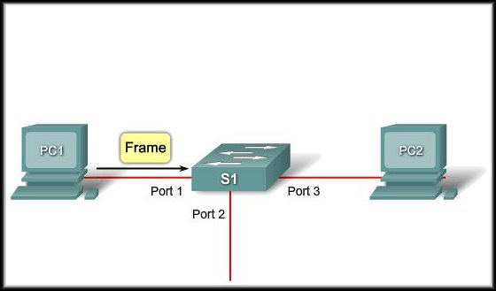
Switch MAC Address Table
Example Step 1:
  The switch receives a broadcast frame from PC 1
  on Port 1.

Slide 13
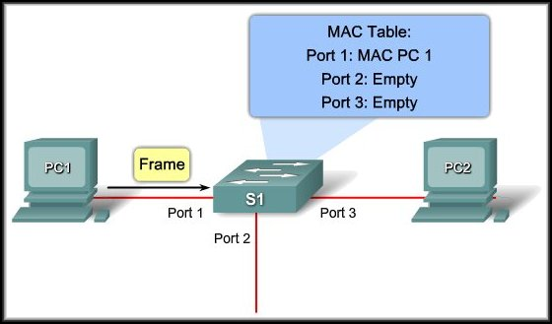
Switch MAC Address Table
Example Step 2:
  The switch enters the source MAC address and the switch port that received the frame into the address table.

Slide 14
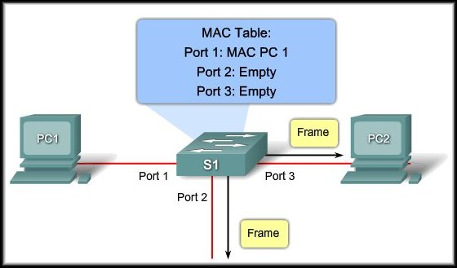
Switch MAC Address Table
Example Step 3:
  Because the destination address is a broadcast, the switch floods the frame to all ports, except the port on which it received the frame.

Slide 15
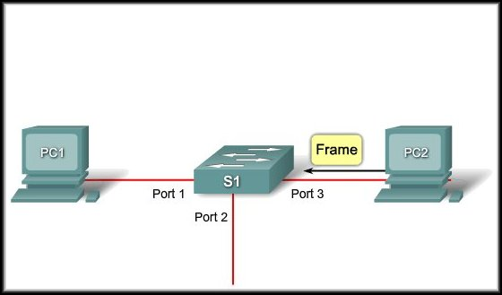
Switch MAC Address Table
Example Step 4:
  The destination device replies to the broadcast with a unicast frame addressed to PC 1.

Slide 16
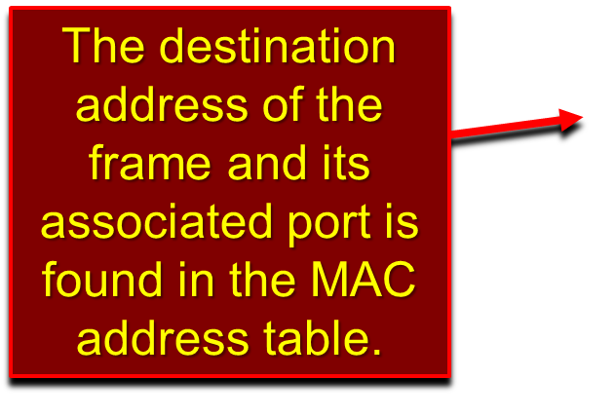
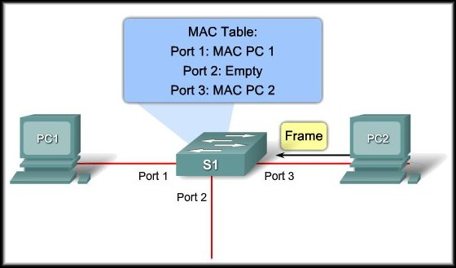
Switch MAC Address Table
Example Step 5:
  The switch enters the source MAC address of PC 2 and the port number of the switch port that received the frame into the address table.

Slide 17
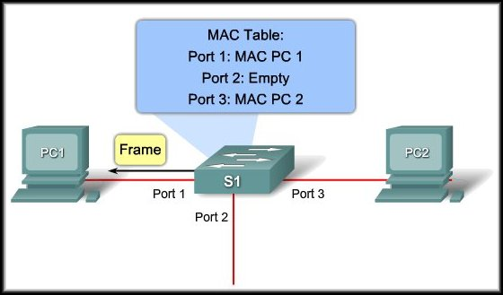
Switch MAC Address Table
Example Step 6:
  The switch can now forward frames between source and destination devices because it has entries in the address table that identify the associated ports.

Slide 18
Design Considerations – Ethernet/802.3
Bandwidth and Throughput:
  A major disadvantage of Ethernet is collisions.
    When two hosts transmit frames simultaneously, the collision results in the transmitted frames being corrupted or destroyed.
    The sending hosts stop sending based on the Ethernet 802.3 rules of CSMA/CD.
  It is important to understand that when stating the bandwidth of the Ethernet network is 10 Mb/s, full bandwidth for transmission is available only after any collisions have been resolved.

Slide 19
Design Considerations – Ethernet/802.3
Bandwidth and Throughput:
  A major disadvantage of Ethernet is collisions.
    A hub offers no mechanisms to either eliminate or reduce collisions and the available bandwidth that any one node has to transmit is correspondingly reduced.
    As a result, the number of nodes sharing the Ethernet network will have effect on the throughput.

Slide 20
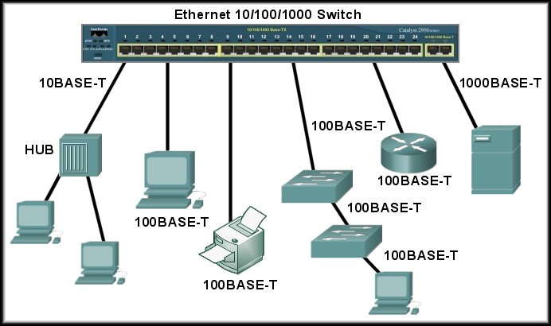
Design Considerations – Ethernet/802.3
Collision Domains:
  To reduce the number of nodes on a given network segment, you can create separate physical network segments called collision domains.
    The network area where frames originate and collide is called the collision domain.
      All shared media environments, such as those created by using hubs are collision domains.
      When a host is connected to a switch port, the switch creates a dedicated connection. This connection is an individual collision domain.

Slide 21
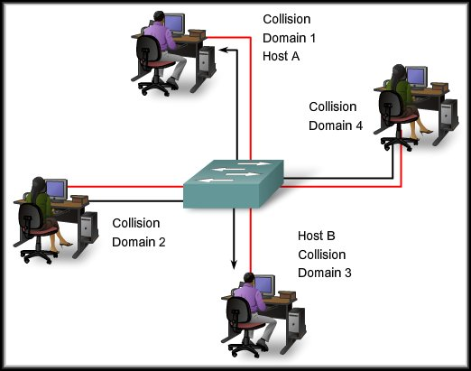
Design Considerations – Ethernet/802.3
Microsegment:
  When two connected hosts want
  to communicate with each other,
  the switch uses the switching
  table to establish a connection
  between the ports.
  The circuit is maintained until the session is terminated.
  The microsegment behaves as if the network has only two hosts, providing maximum available bandwidth to both hosts.
  Switches reduce collisions and improve bandwidth use on network segments because they provide dedicated bandwidth to each network segment.

Slide 22
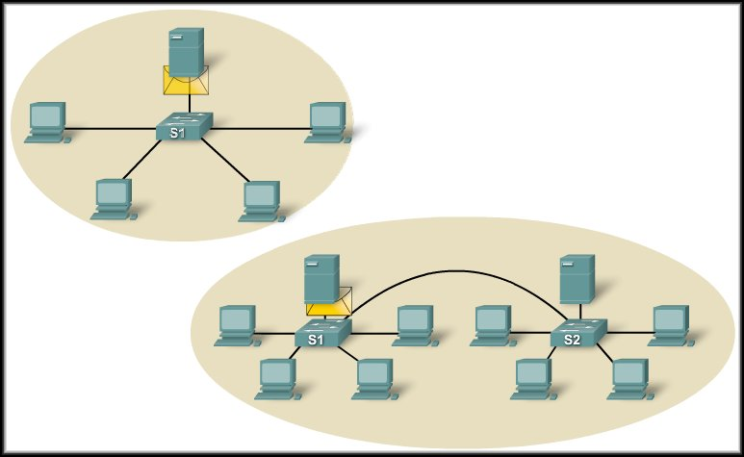
Design Considerations – Ethernet/802.3
Broadcast Domains:
  Although switches filter most frames based on MAC addresses, they do not filter broadcast frames.
  Why?
    Because a switch runs at Layer 2 and cannot learn the MAC address FFFFFFFFFFFF.
  A collection of interconnected switches forms a broadcast domain.
  Only Layer 3 devices or a VLAN form separate broadcast domains.
Interconnecting switches extends the broadcast domain.

Slide 23
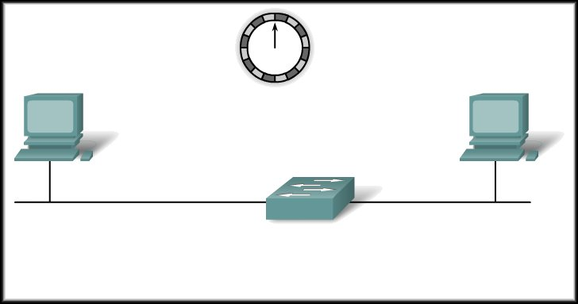
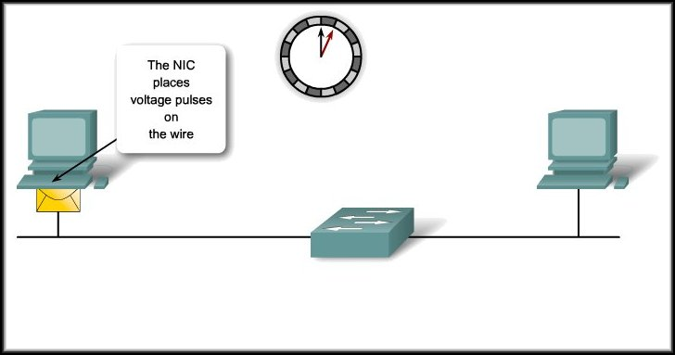
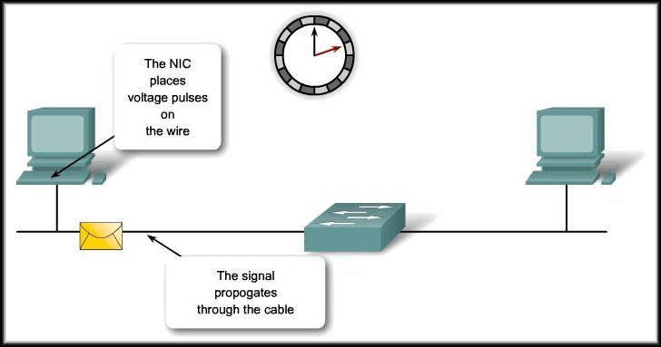
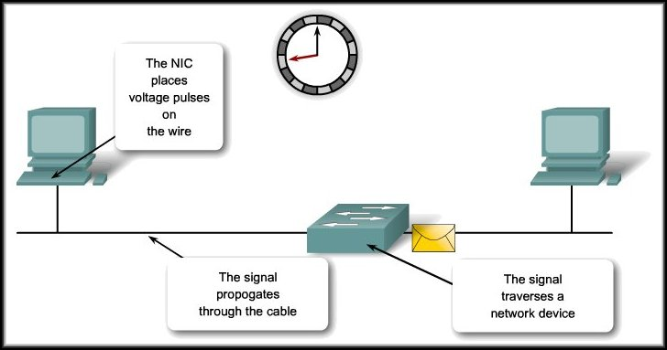
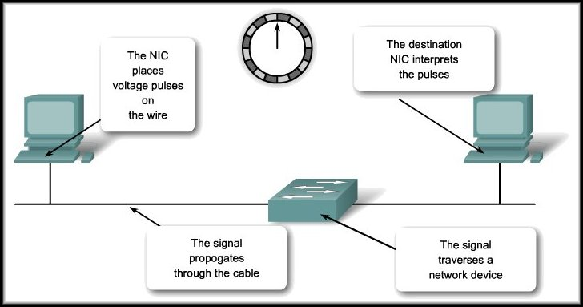
Design Considerations – Ethernet/802.3
Network Latency:
  Latency is the time a frame or a packet takes to travel from the source to the final destination.

Slide 24
Design Considerations – Ethernet/802.3
Network Congestion:
  The primary reason for segmenting a LAN into smaller parts is to isolate traffic and to achieve better use of bandwidth per user.
  Without segmentation, a LAN quickly becomes clogged with traffic and collisions.
  Most common causes:
    Increasingly powerful computer and network technologies.
    Increasing volume of network traffic.
    High-bandwidth applications.

Slide 25
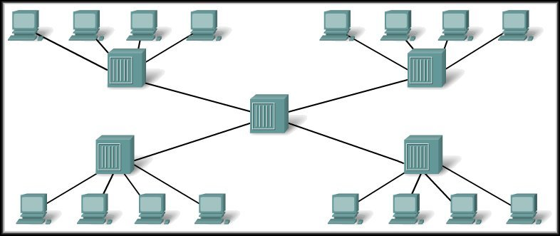


Design Considerations – Ethernet/802.3
LAN Segmentation:
  LANs are segmented into a number of smaller collision and broadcast domains using routers and switches.
Hub

Slide 26



Design Considerations – Ethernet/802.3
LAN Segmentation:
  LANs are segmented into a number of smaller collision and broadcast domains using routers and switches.
JAM
JAM
JAM
JAM
JAM
JAM
JAM
JAM
JAM
JAM
JAM
JAM
JAM
JAM
JAM
JAM
Hub

Slide 27
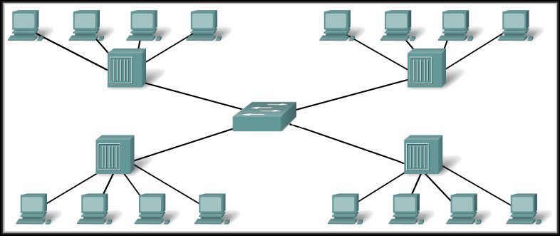
Design Considerations – Ethernet/802.3
LAN Segmentation:
  LANs are segmented into a number of smaller collision and broadcast domains using routers and switches.
Collision Domains
Broadcast Domain
Switch

Slide 28

Design Considerations – Ethernet/802.3
LAN Segmentation:
  LANs are segmented into a number of smaller collision and broadcast domains using routers and switches.
Collision Domains
Broadcast Domains
Router

Slide 29
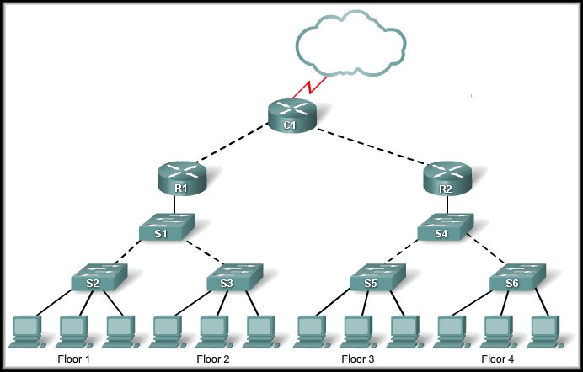
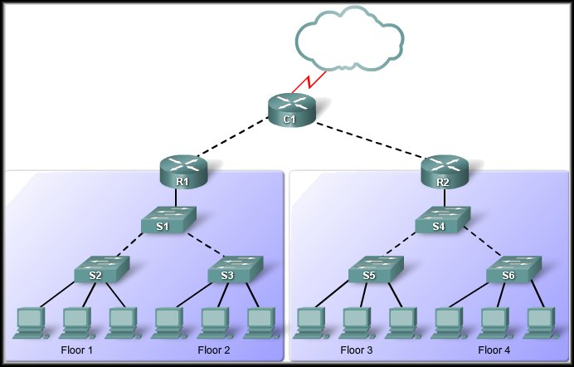
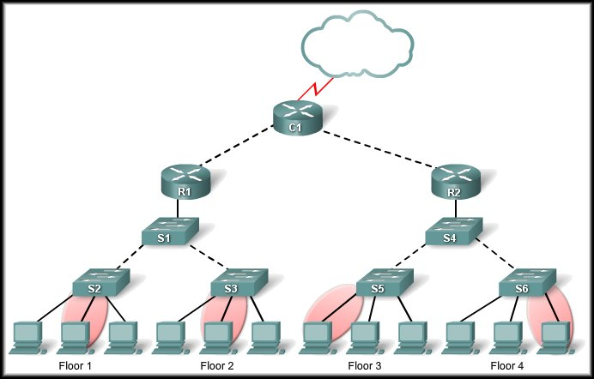
Design Considerations – Ethernet/802.3
LAN Segmentation:
  LANs are segmented into a number of smaller collision and broadcast domains using routers and switches.

Slide 30

Switch Concepts and Configuration
Forwarding Frames
Using a Switch
Store-and-forward
Symmetric
Cut-through
Asymmetric
Fast-forward
Fragment-free
Memory Buffering
Layer 2 and Layer 3 Switching

Slide 31
Switch Forwarding Methods
Methods switches use to forward Ethernet frames.
  Store-and-forward.
  Cut-through:
    Fast-forward switching.
    Fragment-free switching.

Slide 32
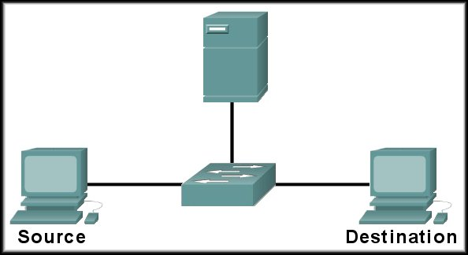
Switch Forwarding Methods
Store-and forward:
  Receives the entire frame.
  Computes the CRC and checks the frame length.
  If valid, checks the switch table for the destination address and forwards the frame.
  If invalid, the frame is dropped.
CRC
Destination
found in
Switching
Table
Frame
is
Good
123896745
=
123896745
Destination | Source | Data | FCS

Slide 33
Switch Forwarding Methods
Store-and forward:
  Receives the entire frame.
  Computes the CRC and checks the frame length.
  If valid, checks the switch table for the destination address and forwards the frame.
  If invalid, the frame is dropped.
  Store-and forward is the only method used on current Cisco Catalyst switches.
    Needed for QoS on converged networks.

Slide 34
Switch Forwarding Methods
Cut-through:
  Forwards a frame before it is entirely received.
  At a minimum, it must read the destination and source MAC addresses.
  Faster than store-and-forward.
  No error checking.
    Any corrupt frames are still forwarded and consume network bandwidth.

Slide 35
Switch Forwarding Methods
Cut-through – Fast-forward:
  Typical method of cut-through.
  Forwards a frame immediately after it reads and finds the destination address.
Cut-through – Fragment-free:
  Stores the first 64 bytes of the frame before forwarding.
    The first 64 bytes of the frame is where most network errors and collisions occur.
    Checks for a collision before forwarding the frame.
Some switches are configured to use cut-through on each port until a user defined error threshold is reached. At that time, they change to store-and forward.

Slide 36
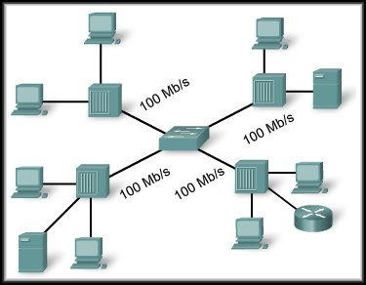
Symmetric and Asymmetric Switching
Symmetric:
  All ports are of the same bandwidth.
  Optimized for a reasonably distributed traffic load.
  For example, a peer-to-peer network.

Slide 37
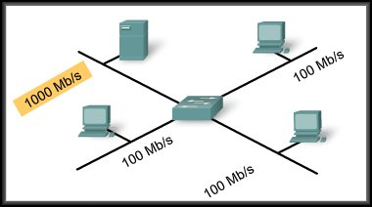
Symmetric and Asymmetric Switching
Asymmetric:
  Provides switched connections between ports
  of unlike bandwidth.
  For example, more bandwidth can be assigned to a server to prevent bottlenecks.

Slide 38
Memory Buffering
A switch analyzes some or all of a packet before it forwards it to the destination host based on the forwarding method.
It stores the packet for the brief time in a memory buffer.
Built into the hardware
  Two types:
    Port based.
    Shared.

Slide 39
Memory Buffering
Port Based:
  Frames are stored in queues that are linked to specific incoming and outgoing ports.
  A frame is transmitted to the outgoing port only when all the frames ahead of it in the queue have been successfully transmitted.
  It is possible for a single frame to delay the transmission of all the frames in memory because of a busy destination port.

Slide 40
Memory Buffering
Shared:
  Deposits all frames into a common memory buffer that all the ports on the switch share.
  The amount of buffer memory required by a port is dynamically allocated.
  The frames in the buffer are linked dynamically to the destination port.
  Allows the packet to be received on one port and then transmitted on another port, without moving it to a different queue.

Slide 41
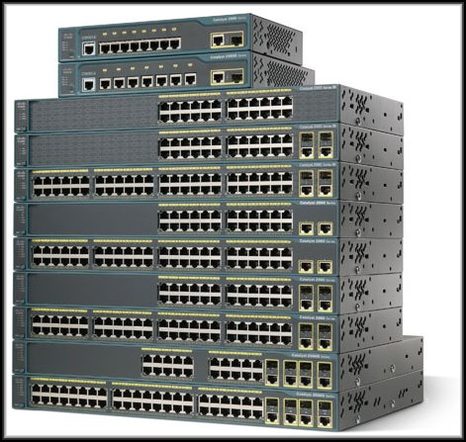
Layer 2 and Layer 3 Switching
Layer 2 Switching:
  Performs switching and filtering based only on the OSI Data Link layer (Layer 2) MAC address.
  Completely transparent to network protocols and user applications.
  Remember that a Layer 2 switch builds a MAC address table that it uses to make forwarding decisions.
Cisco Catalyst
2960 Series

Slide 42
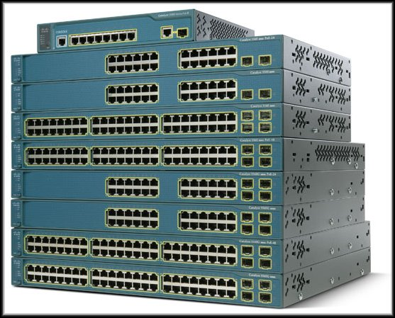
Layer 2 and Layer 3 Switching
Layer 3 Switching:
  Functions similarly to a Layer 2 switch but instead of using only the Layer 2 MAC address a Layer 3 switch can also use IP address information.
  A Layer 3 switch can also learn which IP addresses are associated with its interfaces.
  This allows the Layer 3 switch to direct traffic throughout the network based on IP address information.
Cisco Catalyst
3560 Series

Slide 43
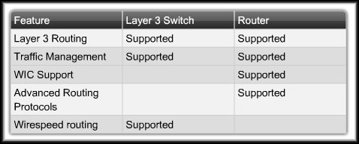
Layer 2 and Layer 3 Switching
Layer 3 Switching:
  However, Layer 3 switches do not completely replace the need for routers on a network.
    Routers perform additional Layer 3 services that Layer 3 switches are not capable of performing.

Slide 44
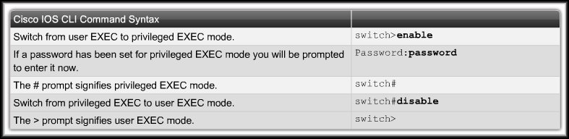
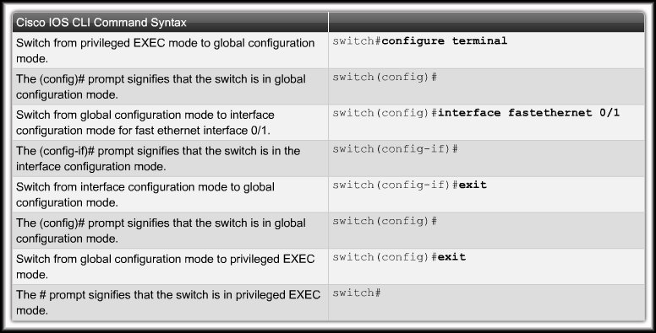
Switch Concepts and Configuration
Switch Management Configuration

Slide 45
Navigating Command-Line Interface Modes
CLI itself is basically the same as a router:
  Access modes with a password.
  Help Facility and Command History
  Configure console and telnet access.
  Commands to configure options for each interface.
  Commands to verify the status of the switch.
The difference is the functions to be configured:
  Commands to create and control VLANs (Chapter 3)
  Configure a default gateway.
  Manage the MAC Address table.
  Switch security.

Slide 46
Navigating Command-Line Interface Modes
Access Levels:
  User EXEC.
  Privileged EXEC.

Slide 47
Navigating Command-Line Interface Modes
Configuration Modes:
  Global Configuration Mode.
  Interface Configuration Mode (and more….)

Slide 48
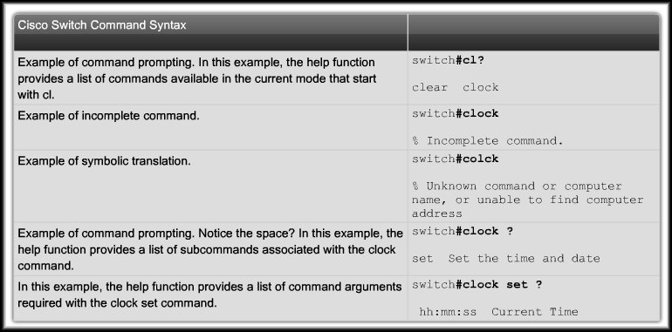
Using the Help Facility
Word / Command line syntax Help:

Slide 49
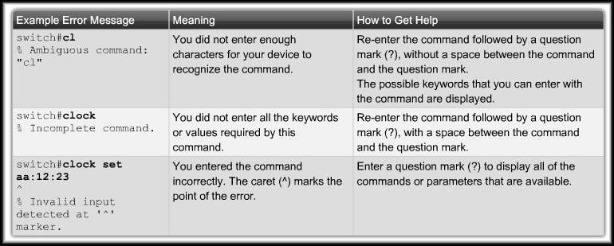
Using the Help Facility
Console Error Messages:

Slide 50
Switch Boot Sequence
Switch loads the Boot Loader program.
  Small program stored in NVRAM.
    CPU Initialization.
    POST.
    Initializes flash memory.
    Loads a default OS image into memory and boots the switch.
  The OS then initializes the interfaces using the Cisco IOS commands found in the operating system configuration file config.text, stored in the switch flash memory.

Slide 51
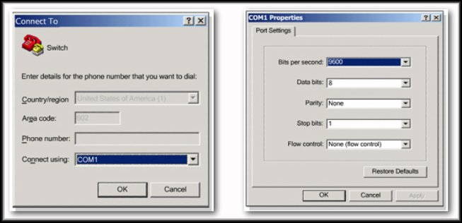
Prepare to Configure the Switch
A PC connected to the console port.
A terminal emulator application (e.g.. HyperTerminal) is running and configured correctly.
Attach the power cord to the switch.
  Some Catalyst switches, including the 2950 and 2960 series switches do not have a power button.

Slide 52
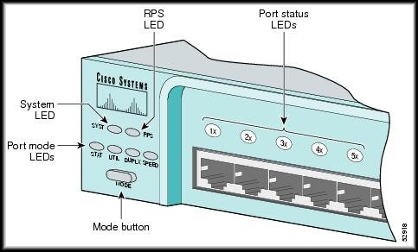
Prepare to Configure the Switch
Observe the Boot Sequence.
  When the switch is powered on, the POST begins.
  During POST, the LEDs blink while a series of tests determine that the switch is functioning properly.
    Successful: the SYST LED rapidly blinks green.
    Fails: the SYST LED turns amber.

Slide 53
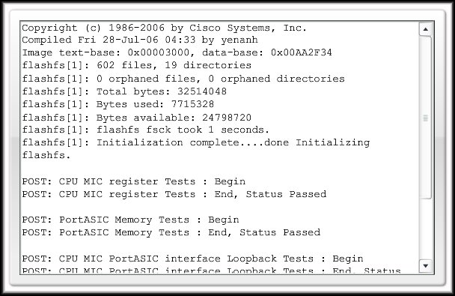
Prepare to Configure the Switch
Observe the Boot Sequence.
  The Port Status LEDs turn amber for about 30 seconds as the switch discovers the network topology and searches for loops.
  If the Port Status LEDs turn green, the switch has established a link between the port and a target, such as a computer.

Slide 54
Basic Switch Configuration
Key Configuration Sequences:
  Switch Management Interface:
    To manage a switch remotely using TCP/IP, you need to assign the switch an IP address.
    An access layer switch is much like a PC in that you need to configure an IP address, a subnet mask, and a default gateway.
  Duplex and Speed of active interfaces:
    Usually the default but can be modified.
  Support for HTTP access.
    We will restrict ourselves to the CLI.
  MAC address table management.

Slide 55
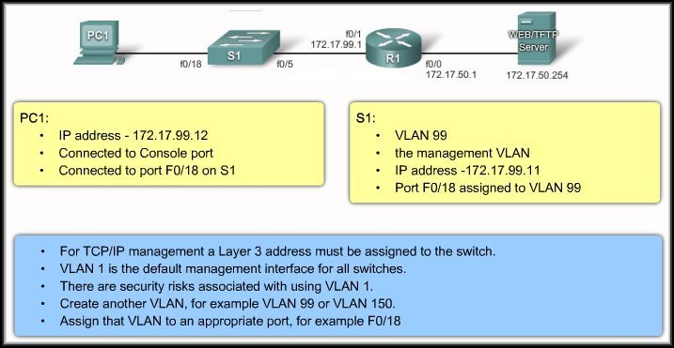
Basic Switch Configuration
Switch Management Interface:

Slide 56
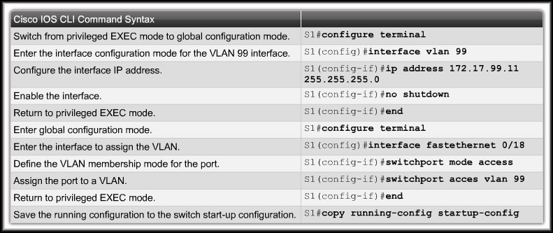
Basic Switch Configuration
Switch Management Interface:
  Note that a Layer 2 switch, such as the Cisco Catalyst 2960, only permits a single VLAN interface to be active at a time.
  This means that the Layer 3 interface (interface VLAN 99) is active, but the Layer 3 interface (interface VLAN 1) is not active.

Slide 57
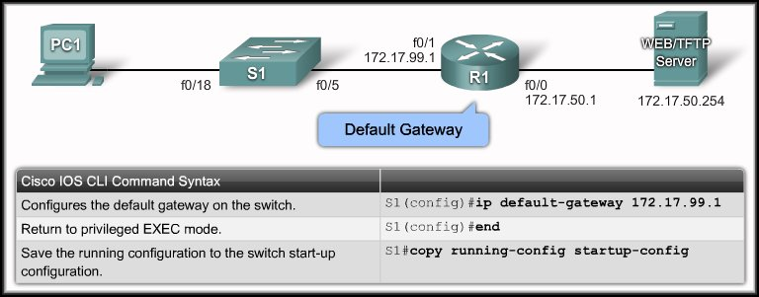
Basic Switch Configuration
Configure Default Gateway:
  You need to configure the switch so that it can forward IP packets to distant networks.
  Remember, the switch is treated like a host in this setup.
  This is only used to forward switch management traffic.
  It has nothing to do with any of the regular user data traffic.
  Why does it have to be forwarded?
    You can make a Telnet or SSH connection to a switch from another subnet to perform maintenance or troubleshoot.

Slide 58
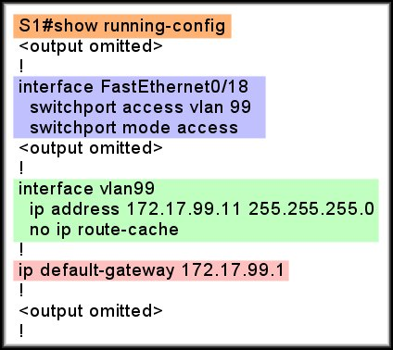
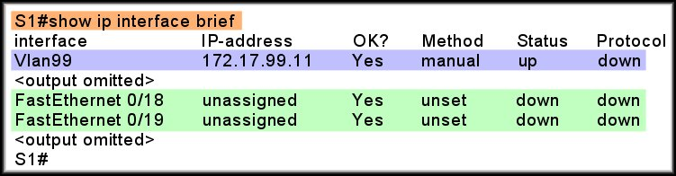
Basic Switch Configuration
Verify Configuration:

Slide 59
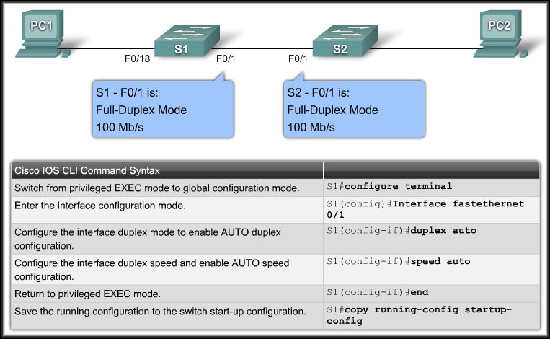
Basic Switch Configuration
Configure Duplex and Speed:
  You can use the duplex interface configuration command to specify the duplex mode of operation for switch ports.
    You can manually set the duplex mode and speed of switch ports to avoid inter-vendor issues with autonegotiation.

Slide 60
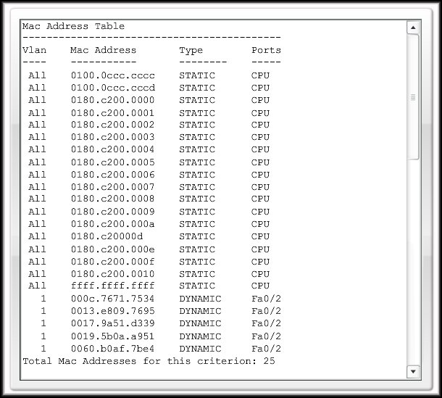
Basic Switch Configuration
MAC Address Table Management:
  Switches use MAC address tables to determine how to forward traffic between ports.
  These MAC tables include dynamic and static addresses.

Slide 61
Basic Switch Configuration
Dynamic MAC Addresses:
  The switch provides dynamic addressing by learning the source MAC address of each frame that it receives on each port.
  It then adds the source MAC address and its associated port number to the MAC address table.
  As devices are added or removed from the network, the switch updates the MAC address table.
    It adds new entries and ages out those that are currently not in use.

Slide 62
Basic Switch Configuration
Static MAC Addresses:
  A network administrator can specifically assign static MAC addresses to certain ports.
  Static addresses are not aged out.
  The switch always knows which port to send out traffic destined for that specific MAC address.
  To create a static mapping in the MAC address table, use the command:
  mac-address-table static <MAC address>
  vlan {1-4096, ALL}
  interface interface-id
  To remove it, use the ‘no’ form of the command.

Slide 63
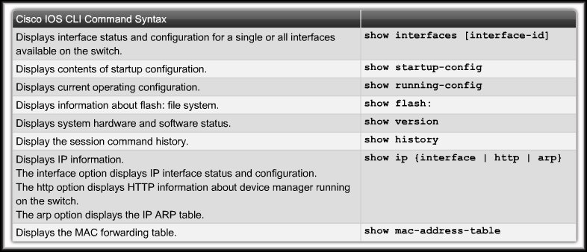
Verifying Switch Configuration
Using the show commands:

Slide 64

Basic Switch Management
Backing up and Restoring Switch Configuration Files:
  Backup to the flash drive.

Slide 65

Basic Switch Management
Backing up and Restoring Switch Configuration Files:
  Restore from the flash drive.

Slide 66

Basic Switch Management
Backing up and Restoring Switch Configuration Files:
  Clearing configuration files.
  Deleting files from the flash drive.
    delete flash:filename

